Slide 2
WHAT IS FIRE.NET?
FIRE.NET INTERNATIONAL is an organization that plays an active role in promoting, influencing and strengthening of policies and public opinion in professionalizing social and economic networking systems in the international, national and local levels.
F- FUN
I- INSPIRATION
R- RECOGNITION
E- EDUCATION

Slide 4
GPRS is an online (web) based transactional and reporting facility, which is capable of doing the following:
Wallet system fund transfer and airtime load transfer.
Bills payment: Meralco, Manila water, Maynilad, Smart, Globe, Sun, etc…
Remittance transaction.
Local and International Ticketing and Booking.

Slide 5
REMITTANCE =
BILLS PAYMENT =
TICKETING & BOOKING =
LOADING =
P1M
Ex. Western Union
P1.2M
Ex. Bayad Center
P300,000/Airline
P800,00/Telecom
P5,000,000.00

Slide 6
Cost Of All Services
Breakdown
Franchise Fee :
Php. 300,000 + 12%VAT
System License Fee :
Php. 100,000 + 12% VAT (License to use the system for 5 years)
Security Bond Deposit :
Php. 100,000.00 (Refundable)
Pre Funding :
Php. 40,000.00 (minimum revolving capital)
GPRS VISA CARD :
Php. 8, 000 (12pcs. @ 600 each)
Php. 596,000.00

Slide 7
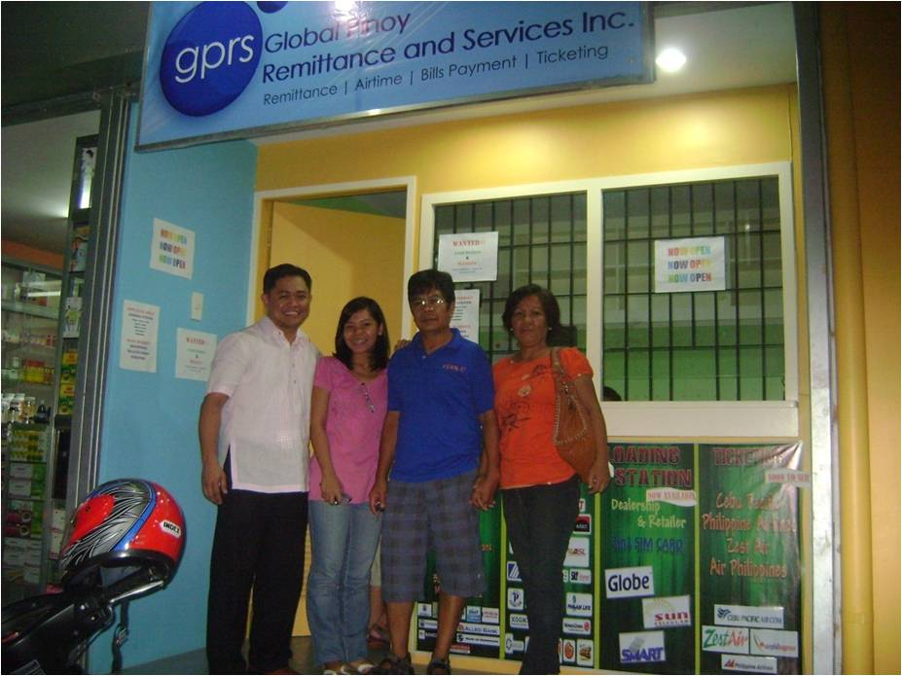
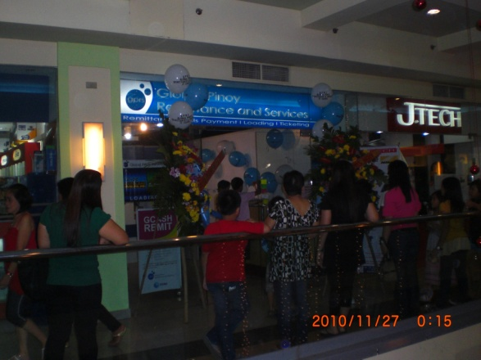
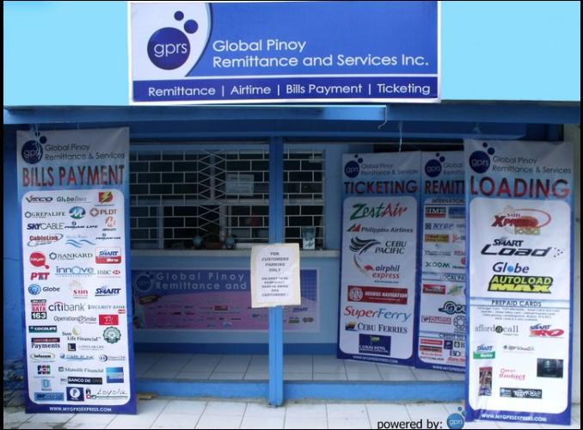
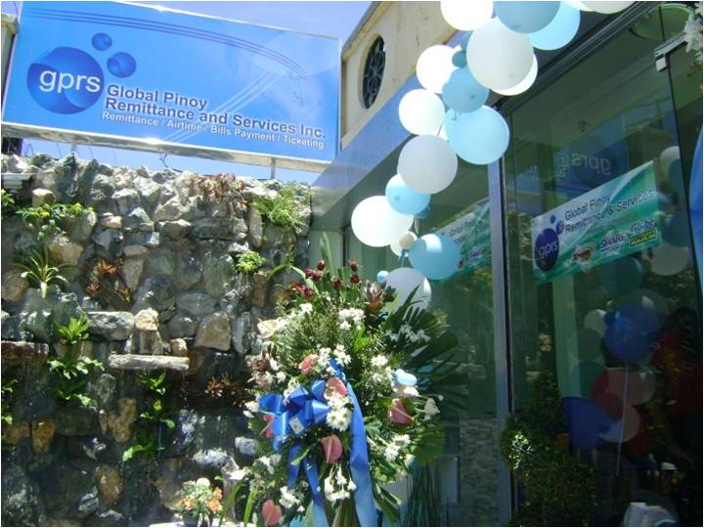
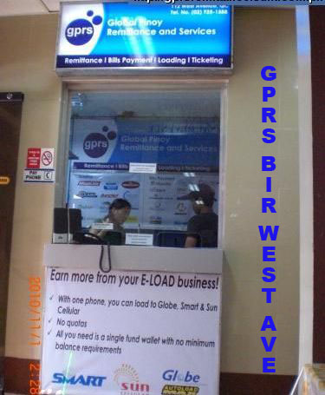
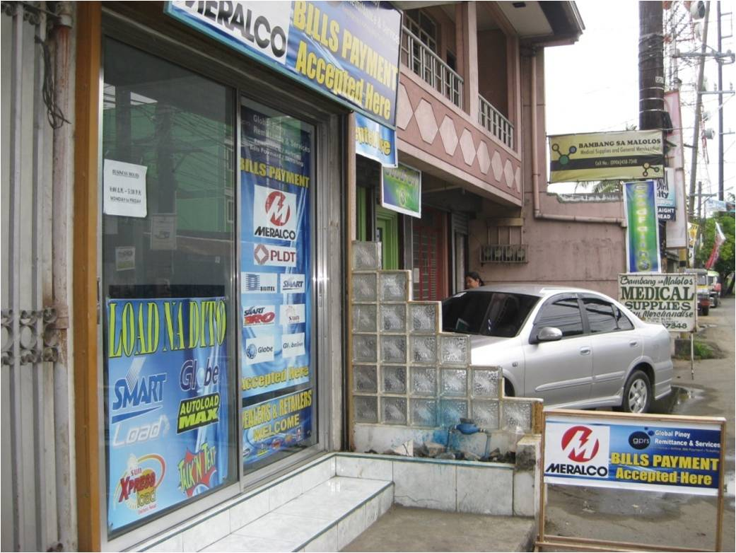
10.BE A GPRS FRANCHISE AGENT
EARN P40,000.00 PER FRANCHISE REFERRAL

Slide 8
DEALER PACKAGE
P7,998
GPRS Business Website
Remittance
Bills Payment
Ticketing & Booking
Unified Loading System
GPRS Visa Card
40 Retailer Activation Cards
Tarpaulin

Slide 9
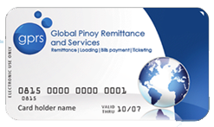
REMITTANCE CARD that enables online crediting of your remittance to your account in minutes.
A VISA CARD that can be used to withdraw cash at ATMs nationwide.
A DEBIT CARD that can be used to shop and pay for your purchases at establishments nationwide and at over 27 million more locations worldwide.
GPRS can enter into Co-brand programs with partners.

Slide 10
GO TO YOUR WEB BROWSER, GO TO www.mygprsexpress.com
Then click MEMBER

Slide 11
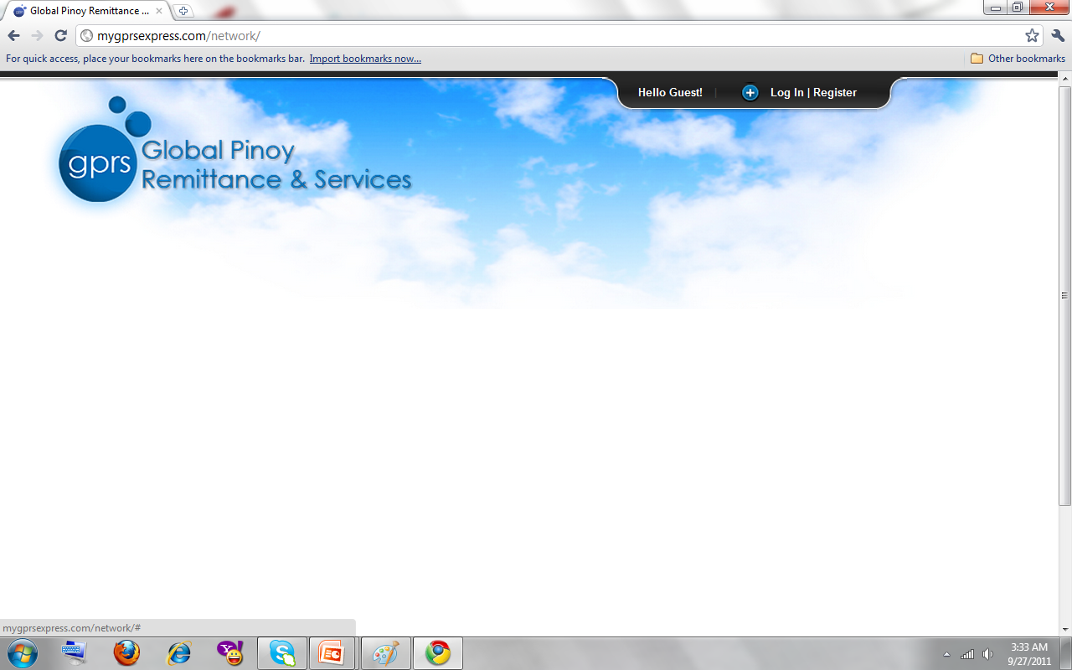
CLICK “Log In | Register”

Slide 12
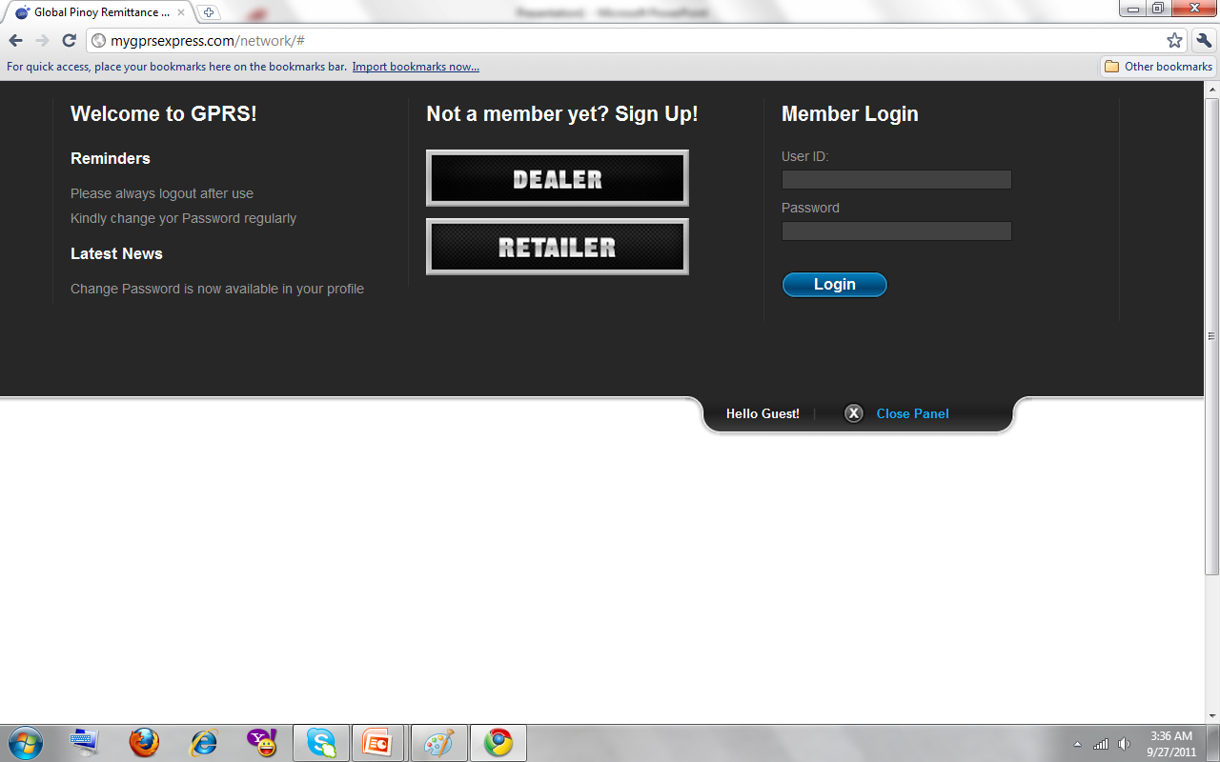
KEY-IN YOUR USER ID AND PASSWORD

Slide 13
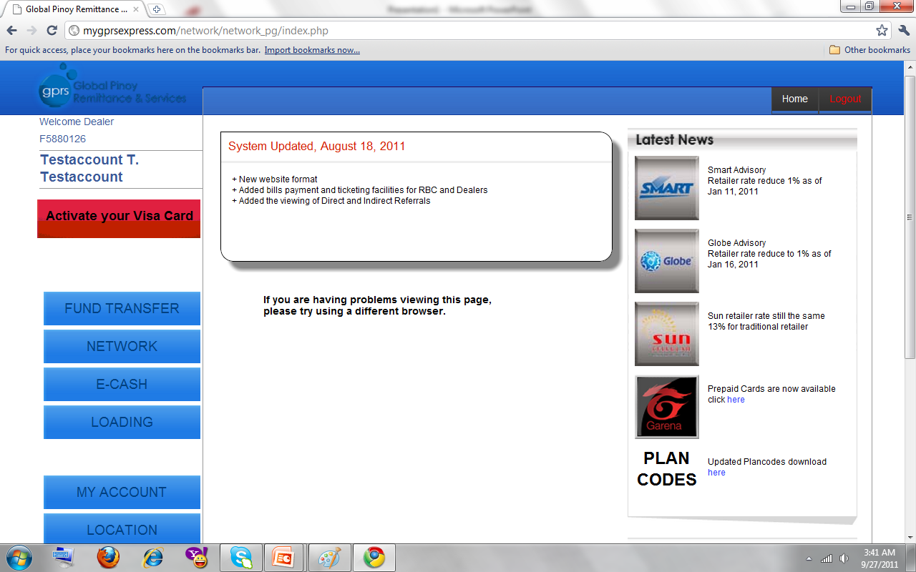

Slide 14
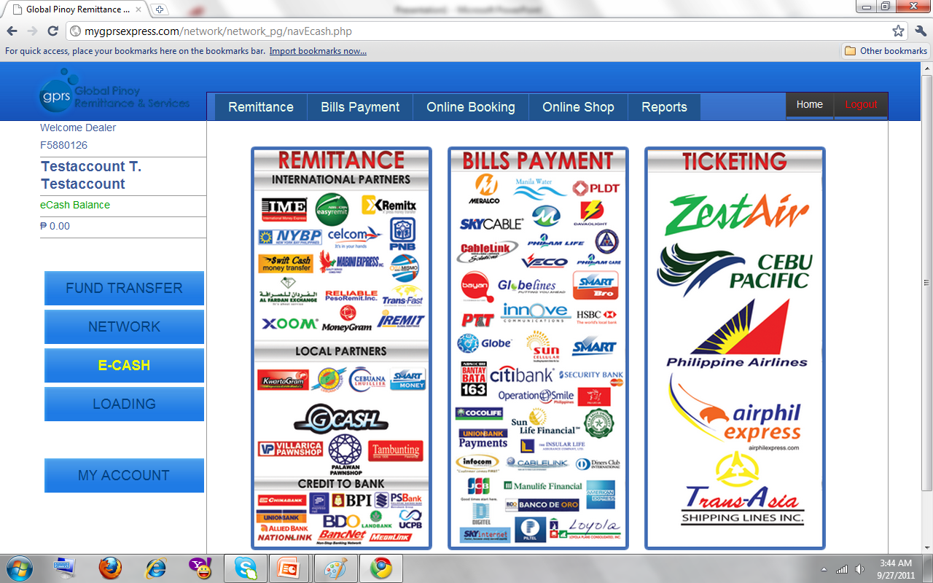

Slide 15
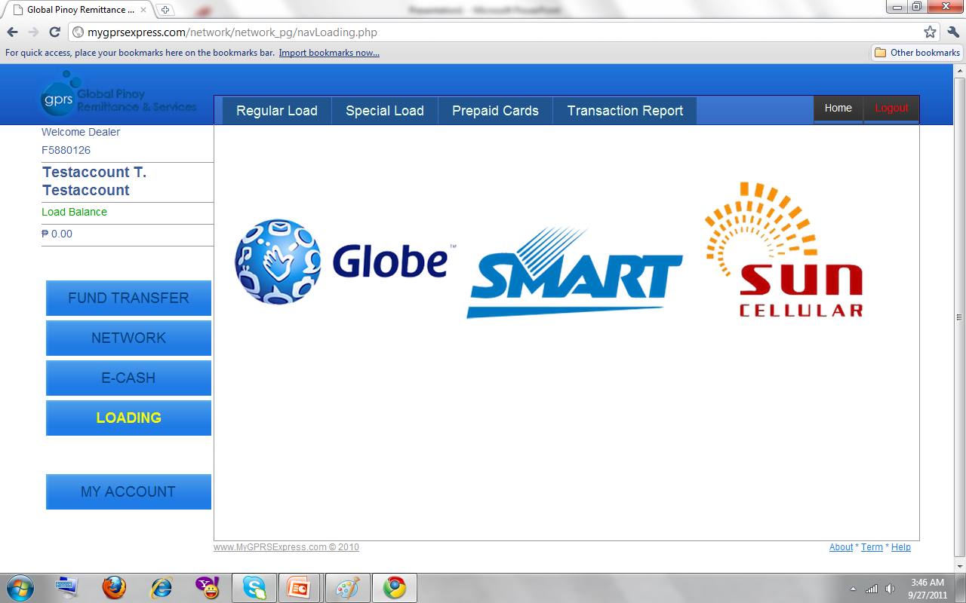

Slide 16
WAYS TO EARN
1. EARN SERVICE FEE FROM YOUR:
REMITTANCE
BILLS PAYMENT
TICKETING

Slide 17
2. EARN MORE FROM YOUR LOADING BUSINESS!!!
UNIFIED LOADING SYSTEM
1 SIM ALL NETWORKS
WEB-LOADING SYSTEM

Slide 18
3. DIRECT SALES
40 R.A.C.
x P300
---------------
P12,000

Slide 19
4. DIRECT REFERRAL INCENTIVE
LEFT
RIGHT
P600.00
P600.00
P600.00
P600/Referral
INVITE AS MANY AS YOU CAN!

Slide 20
5. INDIRECT REFERRAL INCENTIVE
EARN P40 FROM YOUR
2nd GENERATION UP TO YOUR 10th GENERATION!
YOU
P600
DIRECT
REFERRAL
P40
P40
P40
P40
P40
P40

Slide 21
6. POINTS PAIRING BONUS
LEFT
RIGHT
GET P1,000/PTS PAIRING
UP TO 60 PAIRS/DAY!!!
P1,000
P1,000
P2,000
P1,000

Slide 22
SLOW PLAN FEASIBILITY STUDY
1ST MONTH
2ND MONTH
3RD MONTH
4TH MONTH
5TH MONTH
6TH MONTH
7TH MONTH
8TH MONTH
9TH MONTH
10TH MONTH
11TH MONTH
12TH MONTH
2,200
2,000
4,000
8,000
16,000
32,000
64,000
128,000
256,000
512,000
1,024,000
1,800,000
8
16
32
64
128
256
512
1024
2048
8
16
32
64
128
256
512
1024
2048
P3,848,200

Slide 23
BUT WAIT…
THERE’S MORE!!!

Slide 24
7.RESIDUAL INCOME
 | BILLS P1 | REMITTANCE P1 | TICKETING P10
1ST Generation | 10x3x1=P30 | 10x3x1=P30 | 10x2x10=P200
2nd | 10x10x3x1=P300 | 10x10x3x1=P300 | 10x10x2x10=P2000
3rd | 10x10x10x3x1=P3000 | 10x10x10x3x1=P3000 | 10x10x10x2x10=P20,000
4th | 10x10x10x10x3x1=P30,000 | 10x10x10x10x3x1=P30,000 | 10x10x10x10x2x10=P200,000
5th | 10x10x10x10x10x3x1=P300,000 | 10x10x10x10x10x3x1=P300,000 | 10x10x10x10x10x2x10=P2M
6th | 10 x3x1=P3M | 10 x3x1=P3M | 10 x2x10=P20M
7th | 10 x3x1=P30M | 10 x3x1=P30M | 10 x2x10=P200M
8th | 10 x3x1=P300M | 10 x3x1=P300M | 10 x2x10=P2B
9th | 10 x3x1=P3B | 10 x3x1=P3B | 10 x2x10=P20B
10th | 10 x3x1=P30B | 10 x3x1=P30B | 10 x2x10=P200B
6
6
6
7
7
7
8
8
8
9
9
9
10
10
10

Slide 25
GPRS-UCPB-MEGALINK MOA

Slide 26
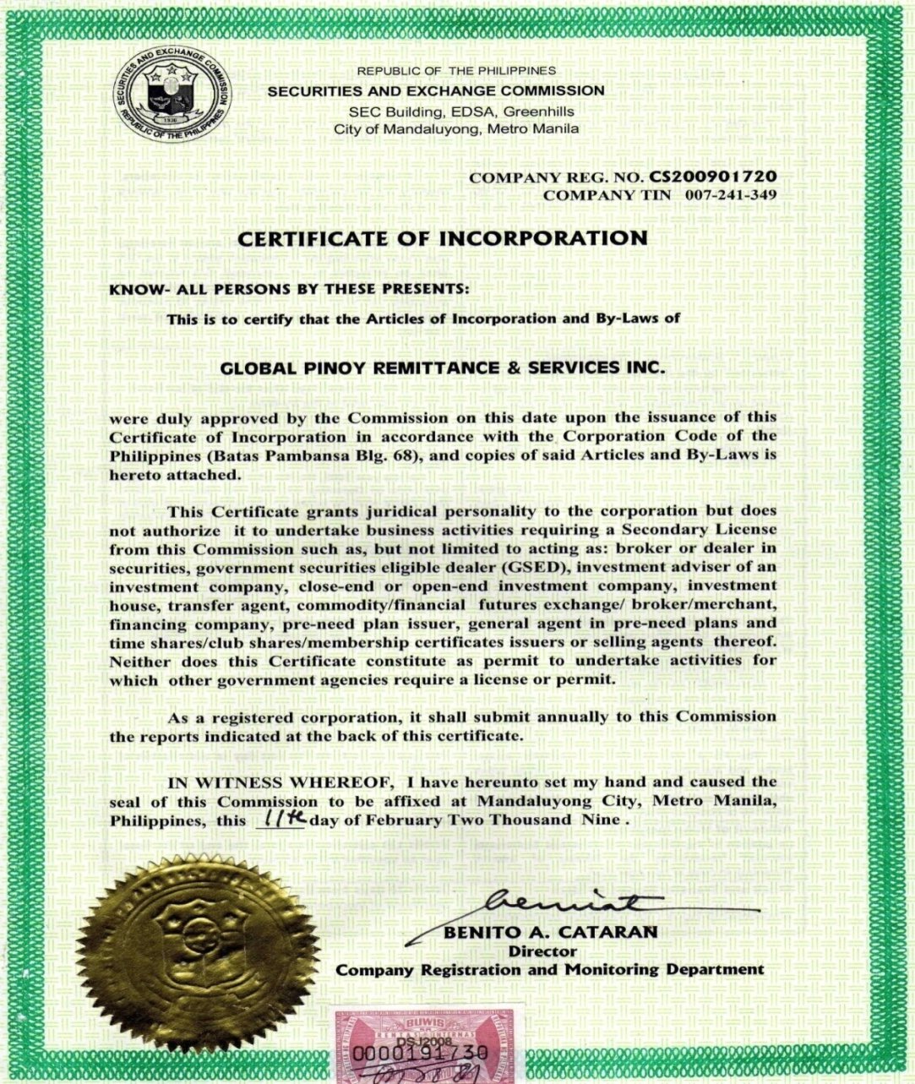
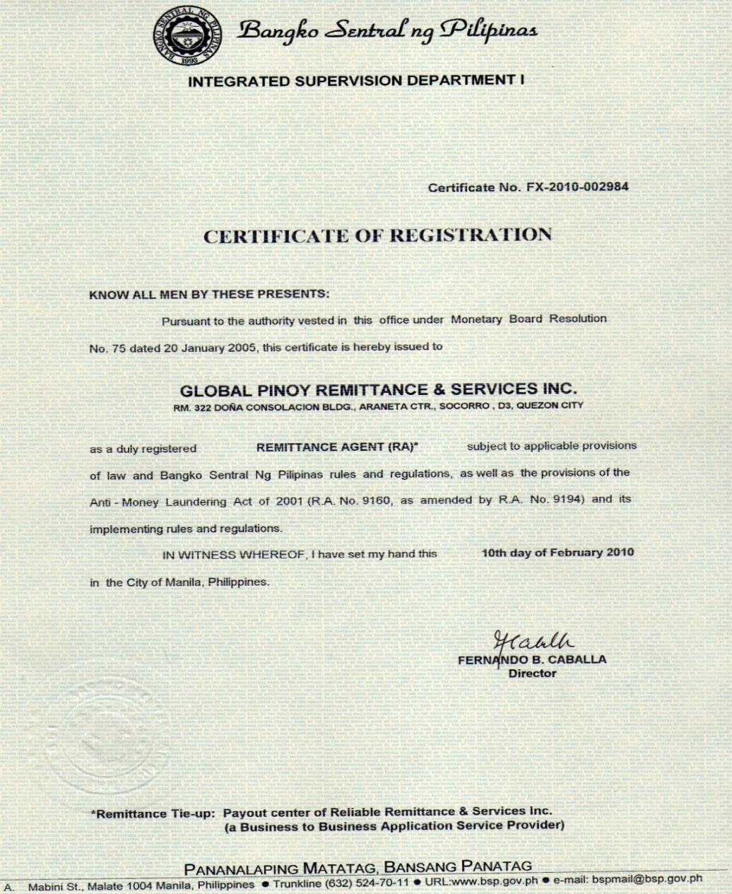
LEGALITIES

Slide 27
This has been a
PRESENTATION
IT BURNS!!!

